Slide 1
DATA SCIENCE CAREER TRACK
CAPSTONE 1
MILESTONE REPORT
by Edward Franke

Slide 2
AGENGA
Executive Summary
Concepts
Attempts
For Loops
Models
Results
The Problem
The Solution

Slide 3
EXECUTIVE SUMMARY
The purpose for this project is to find a correlation connected to fraudulent credit card transactions that can separate them in real time compared to legitimate transactions. The dataset is a cleaned dataset from Kaggle.com. It has been discovered there is a correlation connected to fraudulent transactions. Most models fail to accurate predict which transactions are fraudulent because the dataset is severely unbalanced with over 99% of the transactions being legitimate. The solution was to run SMOTE first to rebalance the dataset then logistic regression with these results:

Slide 4
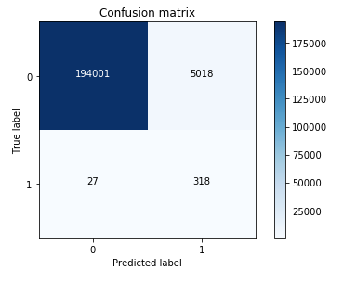

Slide 5
CONCEPTS
IDEA: A model to detect fraud in credit card transactions. (problem to solve)
CLIENT: Credit Card Companies
REASON: If they don’t detect and stop the fraud as it happens, their customer don’t pay the cost, they do. This project is intended to reduce their expenses and increase their profits.
DATA: From Kaggle, a cleaned dataset with 284,807 transactions from 2013 with 492 frauds in total.
SOLUTION: Create a model or analysis to discover what makes fraudulent transaction similar to detect this relationship as it happens.
DETAILS: See Detail Section Below.
DELIVERABLES: Working code that detect fraud as it receives data and a presentation outlining the discoveries and explain the methods used to reach the discoveries.

Slide 6

Findings
This is the code that was used to separate the initial dataframe into separate dataframes only containing fraud or legit transactions.
While comparing the transactions, I noticed fraudulent transactions have a greater histogram area that legitimate transactions. I was under the impression that I could create code to determine any transaction with a total V set as below -17 as fraudulent. However, as this overlayed histogram comparison shows, that would fail the purpose of the project. A solution is still being sought.

Slide 7
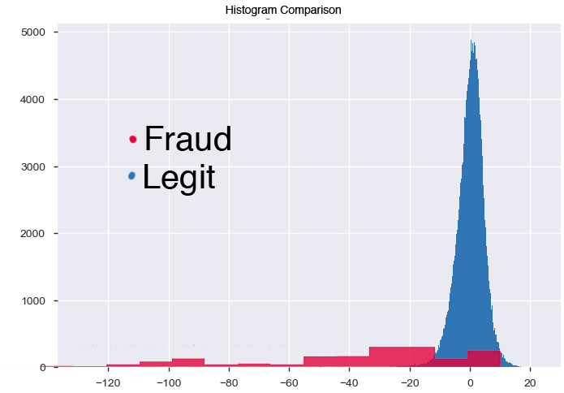

Slide 8
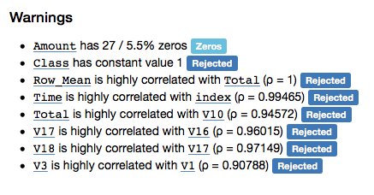
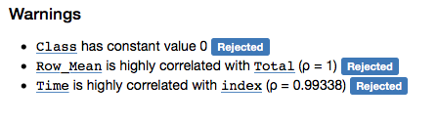
Fraudulent Transactions
Legitimate Transactions

Slide 9
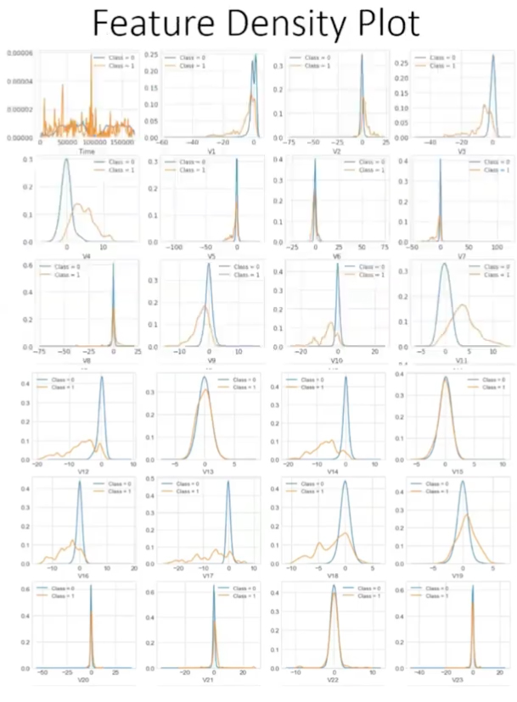

Slide 10
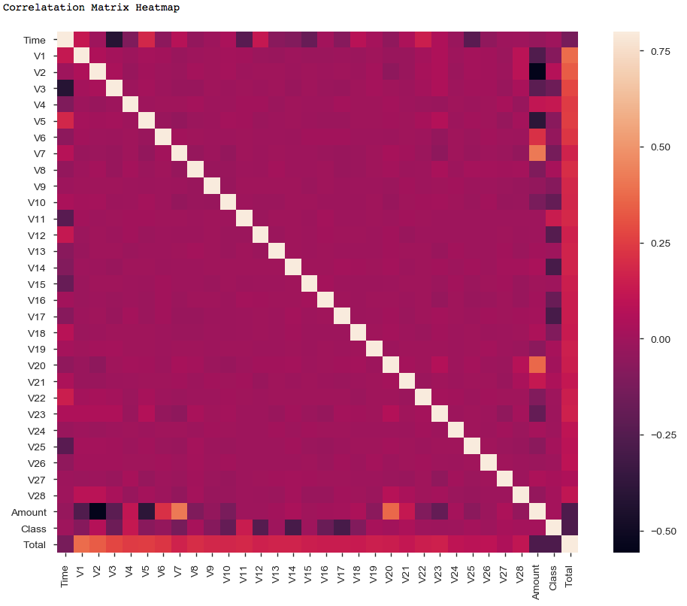

Slide 11
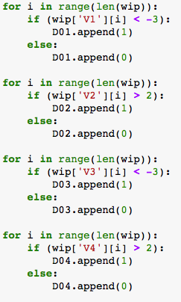
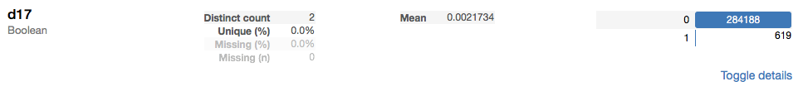
For Loops
V17 appeared to have the best promise with no tweaking of the code. However, this isn’t machine learning techniques so this method was scrapped.

Slide 12
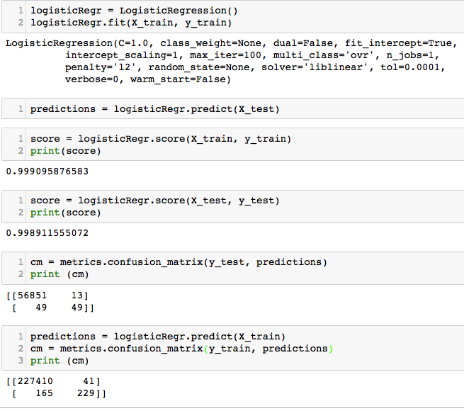
Logistic Regression
The scores look good. However, when running the confusion matrix and comparing both legitimate transactions and fraudulent transactions, there is an issue. Legitimate transactions have great results. However, fraudulent transactions at best have a 50% score. This number is totally unacceptable.

Slide 13
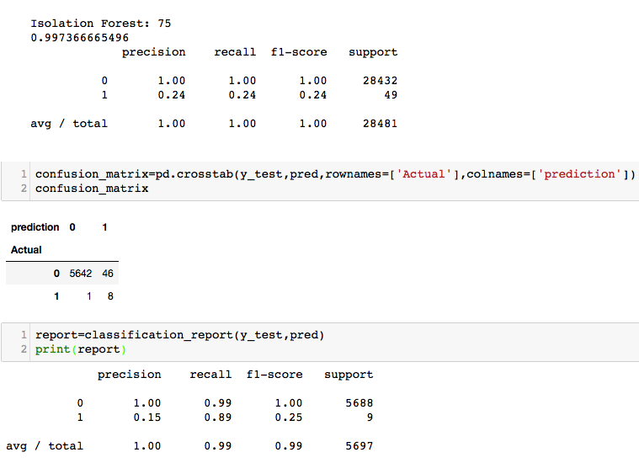
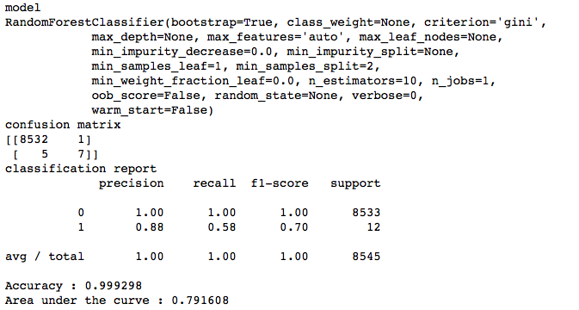
Isolation Forest and Random Forest Models

Slide 14
THE PROBLEM
This is because the dataset has over 99% legitimate transactions and these models are unable to analyze unbalanced datasets properly.
The learning phase and the subsequent prediction of machine learning algorithms can be affected by the problem of unbalanced datasets. The balancing issue corresponds to the difference of the number of samples in the different classes. The decision function of the linear SVM is highly impacted. With a greater unbalanced ratio, the decision function favor the class with the larger number of samples, usually referred as the majority class.

Slide 15
THE SOLUTION
One way to fight this issue is to generate new samples in the classes which are under-represented. The most naive strategy is to generate new samples by randomly sampling with replacement the current available samples. The RandomOverSampler offers such scheme
Apart from the random sampling with replacement, there are two popular methods to over-sample minority classes: (i) the Synthetic Minority Oversampling Technique (SMOTE) [CBHK2002] and (ii) the Adaptive Synthetic (ADASYN) [HBGL2008] sampling method. The solution for this dataset was to use the SMOTE to resample the data and logistic regression to perform the analysis with these results:

Slide 16
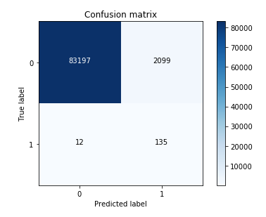

Slide 17
